Slide 1

Foreign Direct Investment (FDI) Analytics Project

Slide 2
Introduction
My name is Deepak Gupta and I am work in Unified Mentor Pvt. Ltd. as a Data Scientist intern. I am select this project during the internship because I feel this is a very interesting project for learn something new skills for my future. This project is related to Finance domain.
Foreign Direct Investment (FDI) is when a company takes controlling ownership of a business in another country, allowing them to be directly involved in its day-to-day operations. In India, net FDI flows dropped by 62.17% in 2023-24 (FY24) to $10.58 billion, the lowest since 2007. This was due to higher capital repatriation and Indian companies investing abroad. The amount being taken out of India by foreign companies has been increasing for longer then the amount invested has been falling. In, FY2029-20, the amount repatriated or disinvested was $18.4 billion, increasing to $44.4 billion in FY24.
Some sectors that have attracted FDI in India include:- Infrastructure, Electronics system design and manufacturing, Information technology, Automotive, Pharmaceuticals, Service, Railways, Chemicals, Textile, Airlines, and Aerospace.

Slide 3
Project Details
Project Title | Foreign Direct Investment (FDI) Analytics
Technologies | Data Science
Domain | Finance
Project Difficulties Level | Intermediate
Tools | Python (Jupiter Notebook), Microsoft PowerBI, Microsoft Power Point, and Microsoft Excel

Slide 4
Objective of the Report
To know the flow of the investment in India.
To know How can India grow by investment?
To Examine the trends and patterns in the FDI across different sectors and from different countries in India.
To know In which sector we can get more foreign currency in terms of investment in India?
To know which country is safe to invest?
To know How much to invest in a developed country or in a developing?
To know Which sector is good for investment?
To know the reason for investment in India?

Slide 5
Problem Statement
Investment is a game of understanding historic data of investment objects under different events but it is still a game of chances to minimize the risk we apply analytics to find the equilibrium investment.
To understand the Foreign direct investment in India for the last 17 years from 2000-01 to 2016-17. This dataset contains sector and financial year-wise data of FDI in India Sector-wise investment analysis Year-wise investment analysis.
Find key metrics and factors and show the meaningful relationships between attributes.

Slide 6
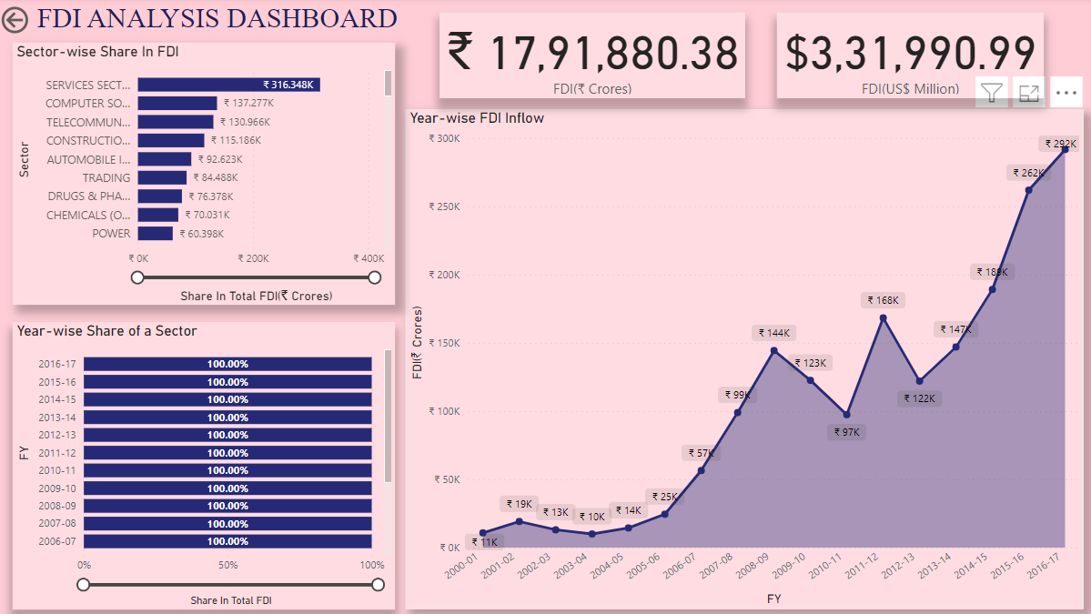
Sector-wise and Year-wise FDI Inflow

Slide 7
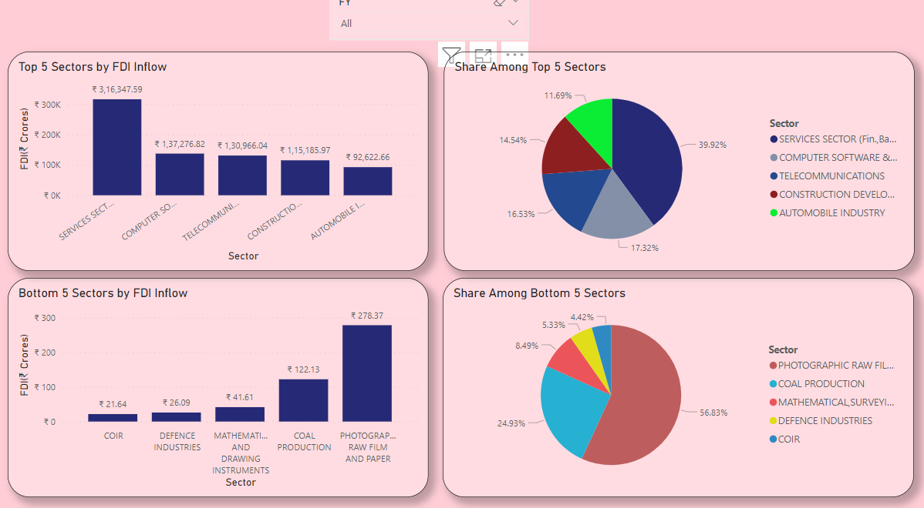
Top and Bottom Sectors in FDI

Slide 8
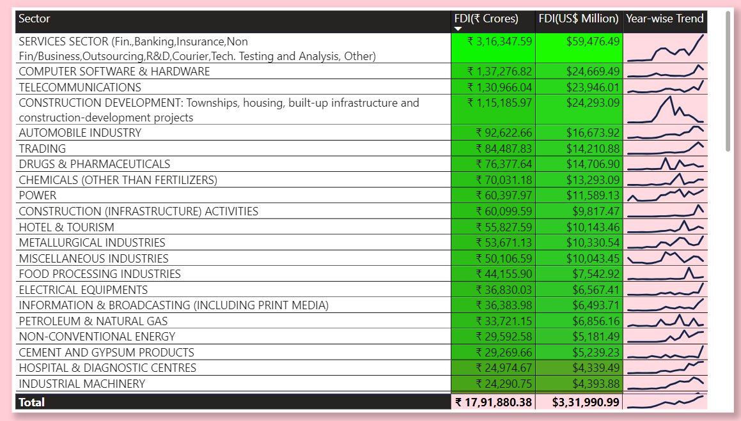
Summary of the Project

Slide 9
Conclusion of the Project
The Sectoral composition of FDI over the period of April 2000 to June 2017, we can find that the largest recipient of such investment is service sector (Financial and non-financial services). The share of this sector in FDI flows is 17% of the inflow total FDI.
The forging investors are interested in mainly financial services due its profit generating advantage. This sector gives scope for the foreign investors to take back the profits to the home country. As service sector the services are consumed in the host country and there by generating outflow of funds from the host country.
The second recipient is Computer software and hardware which shares 7% of total FDI. Telecommunication, Construction Development, Automobile industry, Trade, Drugs and pharmaceuticals, Chemical (Other then Fertilizers), Power, Construction, Hotel and tourism contribute around 7%, 6%, 5%, 4.7%, 4%, 4%, 3%, 3%.

Slide 10
Thank You
Detailed Project Report Submitted by
Deepak Gupta

